Slide 1


System Development Charge Update
City Council Meeting
May 26, 2020

Slide 2
Overview
Background
Overview of Legal Requirements and Methodology
Updated Project Lists and Fee Schedules
Next Steps

Slide 3
Background
Systems Development Charges (SDCs) Defined:
  One-time charge at time of connection or building permit
  Recover capital investments to serve future growth
Existing SDCs
  Based on methodology developed in 2008
  Charged for water, wastewater (sewer), streets, and parks
SDC Update
  Based on system planning updates between 2016-2019
  Includes new stormwater SDC
  Parks update to follow after master plan update

Slide 4
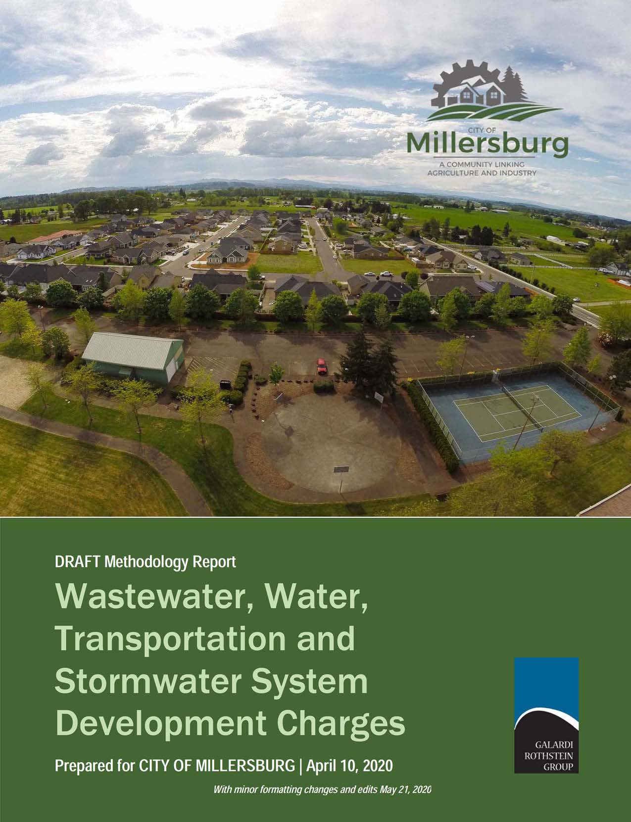
SDC Update Process
Follows Oregon SDC law requirements
  90-day notification to interested parties of public hearing (March 10, 2020)
  Methodology report made available 60 days prior to hearing (April 10, 2020)
Public hearing scheduled for June 10, 2020
Revised project lists and fee schedules for discussion

Slide 5
Basic SDC Methodology
System Specific (water, wastewater, etc.)
Growth Costs ($)
Projected Growth Units
Cost ($) per Unit
Estimated Number of Units
SDC
Development Specific
Notes:
NOTE THAT OVERALL INCREASES CAN BE DEFERED FOLLOWING RATE STRUCTURE CHANGES
We will come back with SDCs at a later date

Slide 6
Determining Growth Costs
Existing Facilities
System Plan Improvements
SDC Criteria:
Existing facility costs
  Available capacity
  City funding
Future improvements included in adopted plan
  Needed for growth within planning period
Capital $
Albany Capital Improvement Plan
SDC Compliance Costs
Notes:
NOTE THAT OVERALL INCREASES CAN BE DEFERED FOLLOWING RATE STRUCTURE CHANGES
We will come back with SDCs at a later date

Slide 7
Defining Growth Units
Water/ Sewer
Dwelling units
Transportation
PM peak hour trips
Stormwater
Equivalent dwelling units
Equivalent dwelling units
Water meter size
Development characteristics
Trip generation
Varies by land use
Adjustments for pass-by trips
Dwelling units
Impervious area

Slide 8
Updates from 60-Day Review

Slide 9
Comparison of Project List Costs
New projects identified (system expansion to service specific areas; Morning Star Rd realignment, etc)
Minor modifications to SDC-eligible share

Slide 10
Updated SDC Schedules
ADU added @50 % of Single Family
Additional land use types added to wastewater EDU schedule

Slide 11
SDC Comparison

Slide 12
Next Steps
June 10 Public Hearing
Update methodology report with revised project list calculations
July 14 Adoption

Slide 13

Questions

