Slide 1


Water and Wastewater Rate Study
City Council Meeting
June 25, 2019

Slide 2
Overview
Background
Financial Forecast
Rate Structure Options
Summary and Next Steps

Slide 3
Background
Master Planning
  2017 Water and Sanitary Sewer Plans adopted
  20-year lists of capital improvements
Rate History
  Last water rate increase in 2012
    Had financial deficit
    Was intended to be first phase to eliminate declining block rate structure
  Last sewer rate increase in 2015
    10% increase (was intended to be first of 3 rate increases)

Slide 4
Current Study Elements
Financial Forecast
Overall revenue increases
Financial performance metrics
Rate Modernization
Fixed and variable charges
Rate alternatives
System Development Charges
New development charges
Recover capital costs for growth
Will be discussed at a later date
Notes:
NOTE THAT OVERALL INCREASES CAN BE DEFERED FOLLOWING RATE STRUCTURE CHANGES
We will come back with SDCs at a later date

Slide 5
Financial Forecast

Slide 6
Financial Forecasting
Annual cash flow projections (revenues and requirements) over 5-10 years
Identify overall revenue increases needed
Sources
of Funds
Operating
Expenses
Capital
Financing
Other
Requirements
Fund Balance
Personnel
Cash Funded
Contingency
Service Charges
Materials
Debt Service
Capital
Reserves
SDCs*
Contract Services
Miscellaneous Fees
Prof. Services
*SDCs = System Development Charges

Slide 7
Key Forecast Assumptions
Revenue
  Moderate residential customer growth in short term (7% per year for 3 years); slower growth thereafter (1.75%)
  Modest decline in water consumption per account (0.5%-1% per year)
    Effects of conservation and price elasticity (from rate increases)
  Flat commercial & industrial
Expenses
  Contract services – 5.5% per year (inflation +growth)
  Other costs – 4-5% per year
  5-Year capital improvements +3% inflation

Slide 8
Forecast Capital Improvements
5-Year funded CIP total about $1 m (with inflation)
Limited improvements currently identified at plants
SDC study will identify growth share

Slide 9
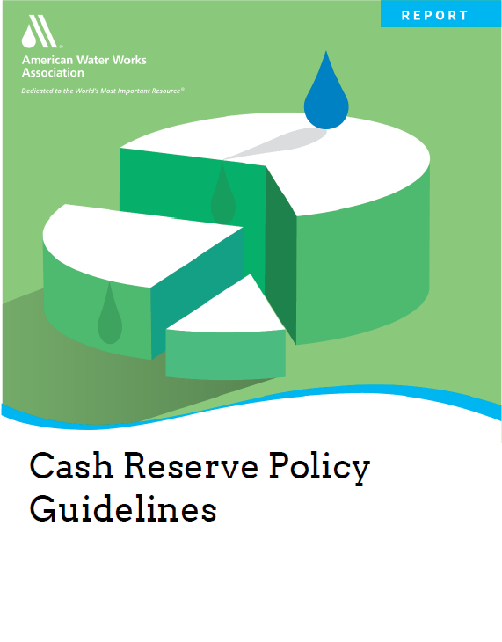
Cash Reserves
“Cash reserve balances are a critical component to a utility’s financial resiliency and sustainability.”
Baseline forecast includes:
  6 months operating contingency (about $400K)
  Economic development reserve ($500K)
Additional capital reserves to consider:
  Future plant improvements
  Other distribution and collection system improvements (unfunded CIP)
2018 American Water Works Association (AWWA)

Slide 10
Baseline Water Fund Forecast
(No Rate Increase)
Notes:
Capital outlay is net of SDC funding, as is debt service)

Slide 11
Baseline Sewer Fund Forecast
(No Rate Increase)

Slide 12
Water Fund Forecast
(Inflationary Rate Increase*)
Unfunded CIP = $1.8 m
*3% beginning in FY2021-22 (following rate structure change)

Slide 13
Sewer Fund Forecast
(Inflationary Rate Increase*)
Unfunded CIP = $5.2 m
(building reserves to this level would require about 9.5% annual increases)
*3% beginning in FY2021-22 (following rate structure change)

Slide 14
Rate Modernization

Slide 15
Current Study Elements
Financial Forecast
Rate Modernization
System Development Charges
Rate alternatives do not include overall revenue increase (assumed to be implemented following rate structure change)
Notes:
NOTE THAT OVERALL INCREASES CAN BE DEFERED FOLLOWING RATE STRUCTURE CHANGES
We will come back with SDCs at a later date

Slide 16
Rate Setting Objectives
Revenue Adequacy
Rate Stability
Equity
Defensible
Beneficial to Economy
  Provide for needed capital and operations funding
  Smoothing overall increases
  Transitioning rate structure changes
  Reflect system usage
  Customer class characteristics
  Follow industry standard practices
  Avoid rate shock
  Consider specific characteristics of large users

Slide 17
Current Water Rates
Base Charges (right)
  Invariant with volume of water used
  Vary with meter size and class
Volume Charges (bottom)
  Differ by class
  Declining block structure
Meter Size | $/Month
 | Res | C&I
¾” | $12.41 | $16.25
1” | $16.37 | $23.73
1.5” | $24.56 | $54.09
2” | $36.88 | $86.58
3” |  | $173.33
4” |  | $270.78
6” |  | $541.39
Class | $/ccf |  | Block 1
 | Block 1 | Block 2 | Cut-off (ccf)
Residential | $2.55 | $2.20 | 6
Commercial/ Industrial | $2.55 | $2.00 | Varies (34 - 60)

Slide 18
Revised Water Rate Structure*
Uniform Volume Rates
  All usage charged at same rate
  Lower rate for industrial based on lower peak demand
Implementation Options
  All at once (option 1)
  2-year phase-in for residential & commercial (option 2)
Class | Current |  | % Use | Year 1 (Option 2) |  | Option 1 or Year 2 (Option 2)
 | Block 1 | Block 2 | Block 2 | Block 1 | Block 2 | All Use
Residential | $2.55 | $2.20 | 52% | $2.55 | $2.37 | $2.55
Commercial | $2.55 | $2.00 | 48% | $2.55 | $2.26 | $2.55
Industrial | $2.55 | $2.00 | 97% | $2.03 | $2.03 | $2.03
*Reflects rate structure change only; no overall revenue increase

Slide 19
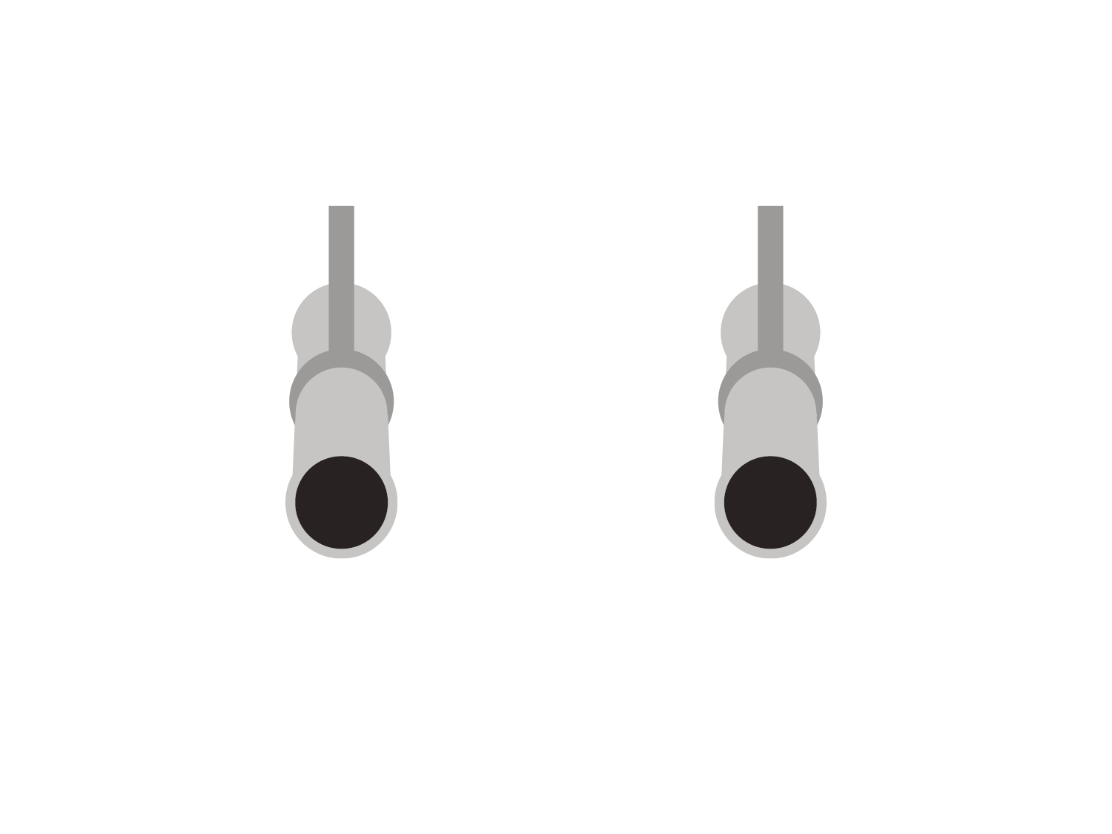


Water System Peak vs. Average Demand
Example: Transmission Mains
Transmission main for average day demand
Transmission main for peak summer day demand

Slide 20
Customer Class Usage Profiles
Under cost-of-service framework, lower peak/average users pay lower rates
Examples of other utilities with class-based rates (Salem, Hillsboro, Gresham)
Peak/Average ratio = 2.1
Peak/Average ratio = 1.4
*Commercial same as residential

Slide 21
Sample Bill Impacts* - Residential
Summer Average = 21 CCF
*Reflect rate structure change only; no overall revenue increase

Slide 22
Sample Bill Impacts – Commercial
(3/4” meter)*
Summer Average = 50 CCF
*Bill impacts vary by meter size; larger meters have lower % increases due to more use currently charged at block 1 (higher) rate

Slide 23
Sample Bill Impacts – Industrial
(4” meter)
*Reflect rate structure change only; no overall revenue increase

Slide 24
Current Sewer Rates
Residential
  Flat rate - invariant with volume of water used
Commercial & Industrial
  Minimum charge applies to majority of customers
  Larger customers (15) charged based on prior-established volumes
Industrial Unit Charges
  Based on City of Albany rates
  Applied to 1 customer only currently
Base Rates | Monthly
 | Charge
Residential | $49.14
Com/ Ind. Minimum | $69.63
Com/Ind. Volume Based | Varies
Industrial Units | $/unit
Flow ($/CCF) | $3.68
BOD ($/lb) | $0.95
TSS ($/lb) | $1.27

Slide 25
Revised Sewer Rate Structure – Conceptual Framework*
Combined base and volume rate structure
  Residential volume based on average winter month
  Commercial & industrial based on actual water use or monitored sewer flow
Above domestic strength users
  Commercial based on class average
  Industrial based on specific unit charges and sampling data
Component | Residential Example
 | Current | Revised
Base | $49.14 | $35.00
Volume | na | $2.80
*Reflects example rate structure change only; no overall revenue increase

Slide 26
Sample Bill Impacts – Rate Structure Change Only
Winter Average = 5 CCF

Slide 27
Summary
Financial plans
  Rate increases needed in next 5 years to continue to meet operating and funded capital costs
    Smoothing (e.g., inflationary increases) vs. one-time larger increases
    Larger increases needed for sewer due to capital needs
  May defer overall increases 1-2 years to allow rate structure changes
Water Rate Structure
  Modern rate structure based on uniform volume rates by class
  2-year phase in would moderate bill impacts to residential and commercial customers
Sewer Rate Structure
  Volumetric rates would result in significant bill impacts (up and down)
  Additional analysis needed for above domestic strength commercial and industrial customers
Rate structure changes require annual monitoring of revenue and water use patterns

Slide 28
Next Steps
Rate analysis
  Refine sewer rate structure for commercial and industrial
  Refinement of capital improvement costs at water/sewer plants
SDC analysis

Slide 29

Questions

